Slide 1
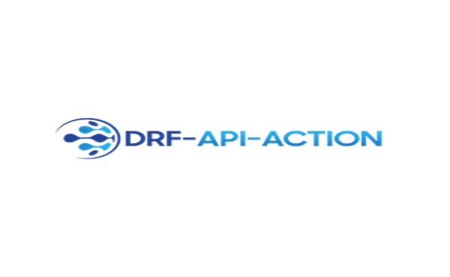
Making web api testing easy

Slide 2

Who Am I?
28 years old, from Givatayim.
Ex-8200.
Worked in several startups.
Was a digital nomad.
Currently working at bluevine.
Creator of drf-api-action.
Github: Ori-Roza Linkedin: Ori Roza

Slide 3
Lecture Agenda
drf-api-action?
Intro main components in django-rest-framework
What is a Serializer?
What is the @action decorator?
What is a ViewSet?
drf-api-action internals
Mocking Request object
Injecting our mocked request and serializer class
Put it all together
drf-api-action benefits & examples
Explicitly & Simplicity
Method traceback is explicit
Pagination

Slide 4
drf-api-action?
A pytest plugin for django-rest-framework endpoint testing.
Giving the ability to call endpoint as they where a simple functions.
Support in exception traceback, pagination…

Slide 5
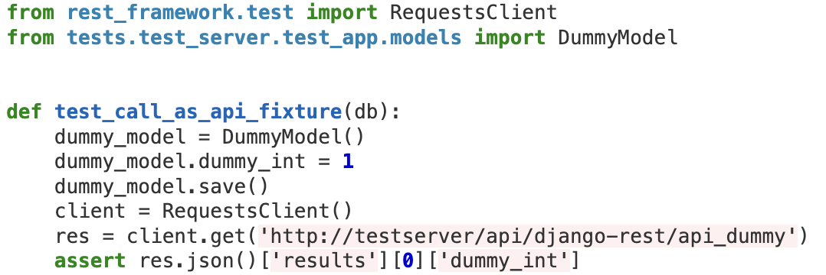
drf-api-action?

Slide 6
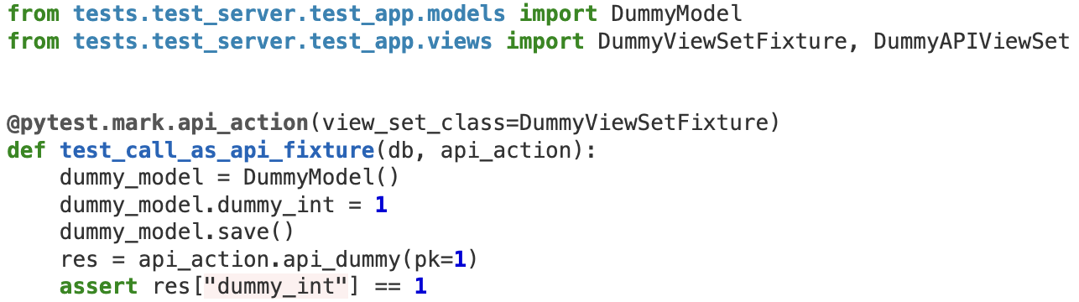
drf-api-action?

Slide 7
What is a Serializer?
Intro main components in django-rest-framework
Based on docs: “”” Serializers allow complex data such as querysets and model instances to be converted to native Python datatypes that can then be easily rendered into JSON, XML or other content types. Serializers also provide deserialization, allowing parsed data to be converted back into complex types, after first validating the incoming data. “””

Slide 8
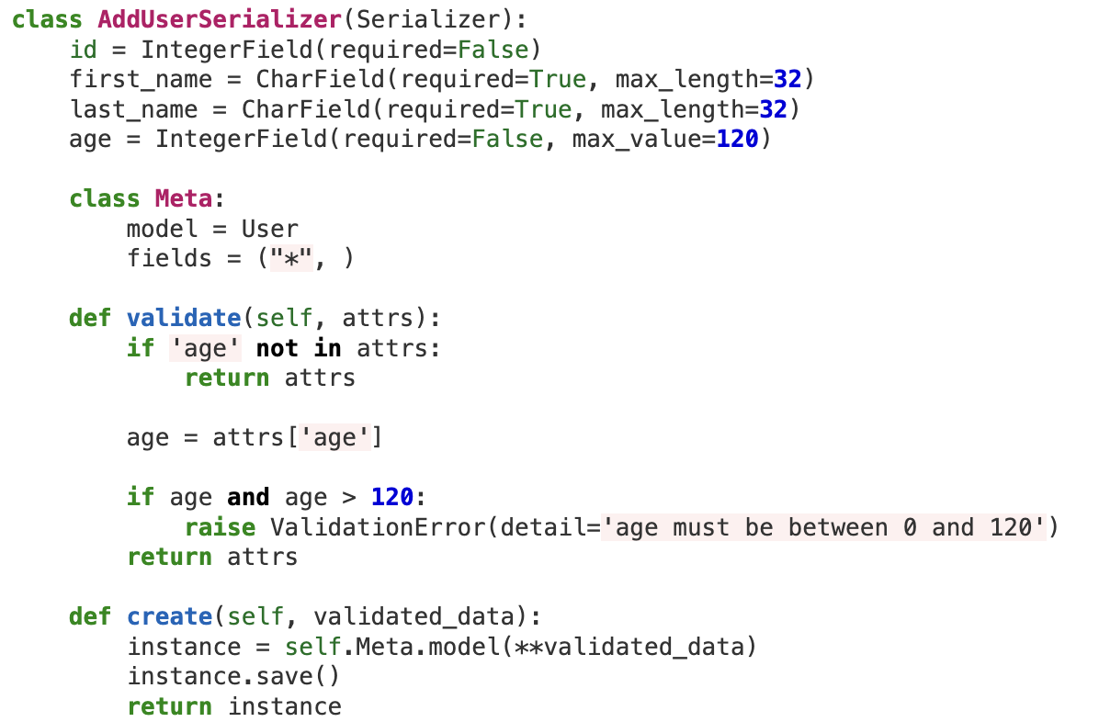
What is a Serializer?
Intro main components in django-rest-framework

Slide 9
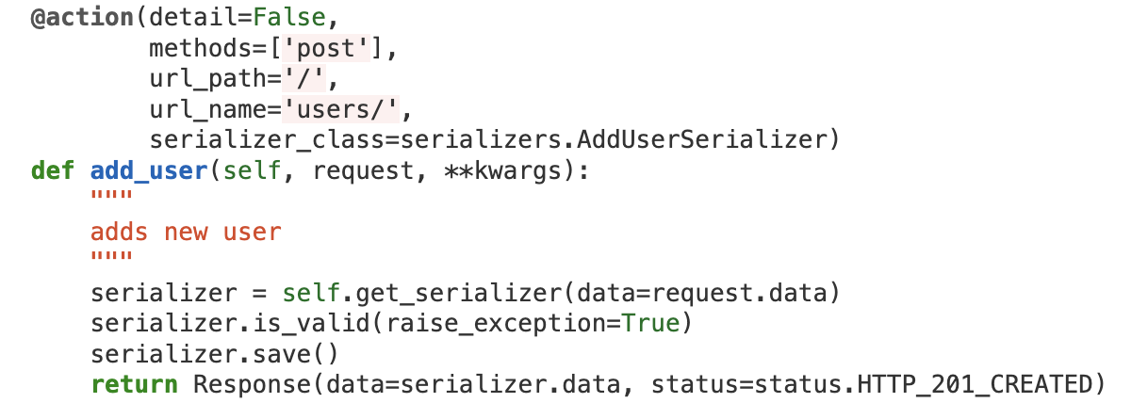
What is a Serializer?
Intro main components in django-rest-framework

Slide 10
What is @action decorator?
Intro main components in django-rest-framework
Based on docs: “”” If you have ad-hoc methods that should be routable, you can mark them as such with the action decorator. “””
This decorator is very straightforward. It defines a route in a ViewSet and usually requires the following arguments:
detail: whether the call expects to get PK or not.
methods: which methods the call supports.
serializer_class: the serializer that handles the specific view.

Slide 11
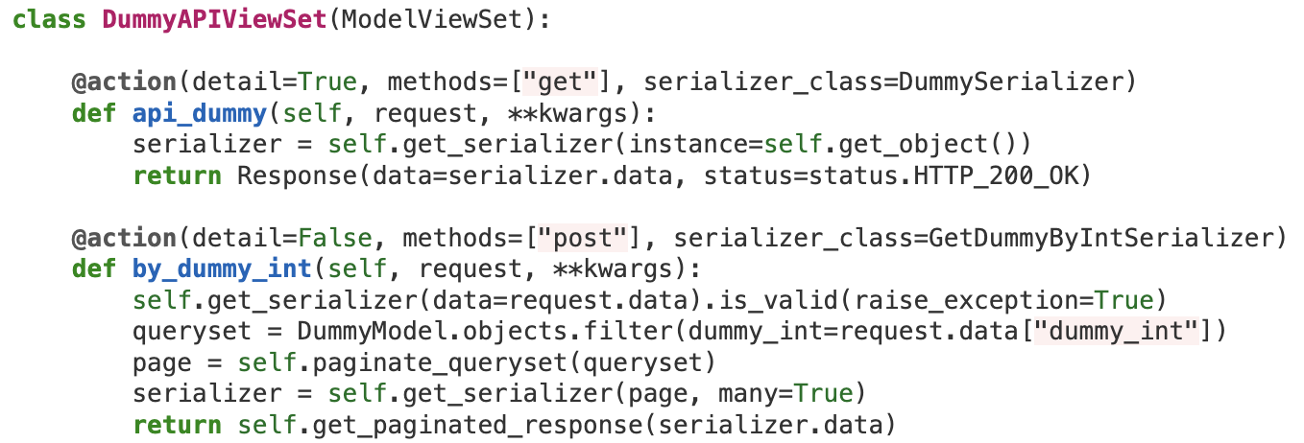
What is a ViewSet?
Intro main components in django-rest-framework

Slide 12
Mocking Request object
drf-api-action internals
Each endpoint method expects an HTTPRequest object
Request data commonly represented in request object by `.data` or `query_params` attributes.
Request is passed to the endpoint & needs to be injected in ViewSet.
We need minimum requirements to create our mocked Request object.

Slide 13
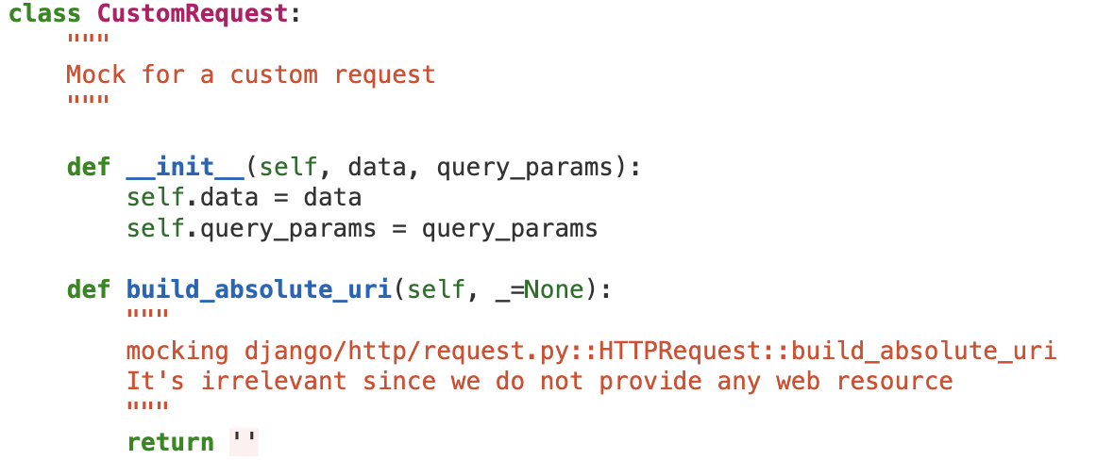
Mocking Request object
drf-api-action internals

Slide 14
Injecting our mocked request and serializer class
drf-api-action internals
Each endpoint method uses a serializer from action decorator’s `serializer_class` param or default one from viewset.
DRF injects the right serializer to each endpoint in runtime.
We want to follow this behavior and inject the corresponded serializer on each method run.

Slide 15
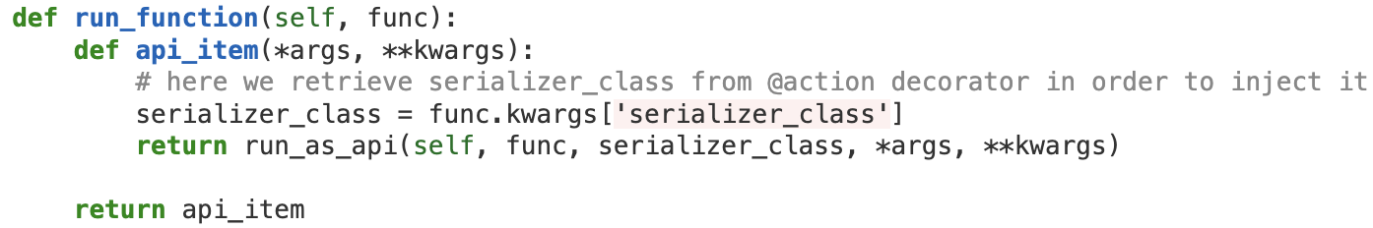
Injecting our mocked request and serializer class
drf-api-action internals
First, extract serializer_class parameter from endpoint’s @action:
func - an endpoint (method) from our ViewSet (we will get to it later)

Slide 16
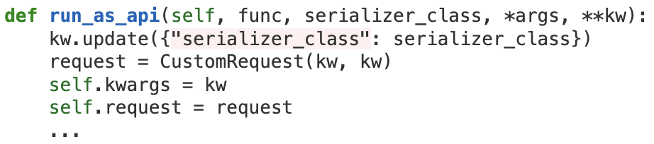
Injecting our mocked request and serializer class
drf-api-action internals
Second, we will inject our objects into our viewset instance:

Slide 17
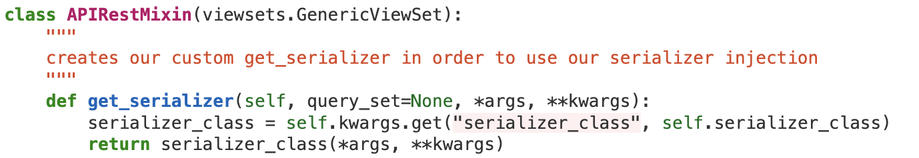
Injecting our mocked request and serializer class
drf-api-action internals
Third, we will override get_serializer method:

Slide 18
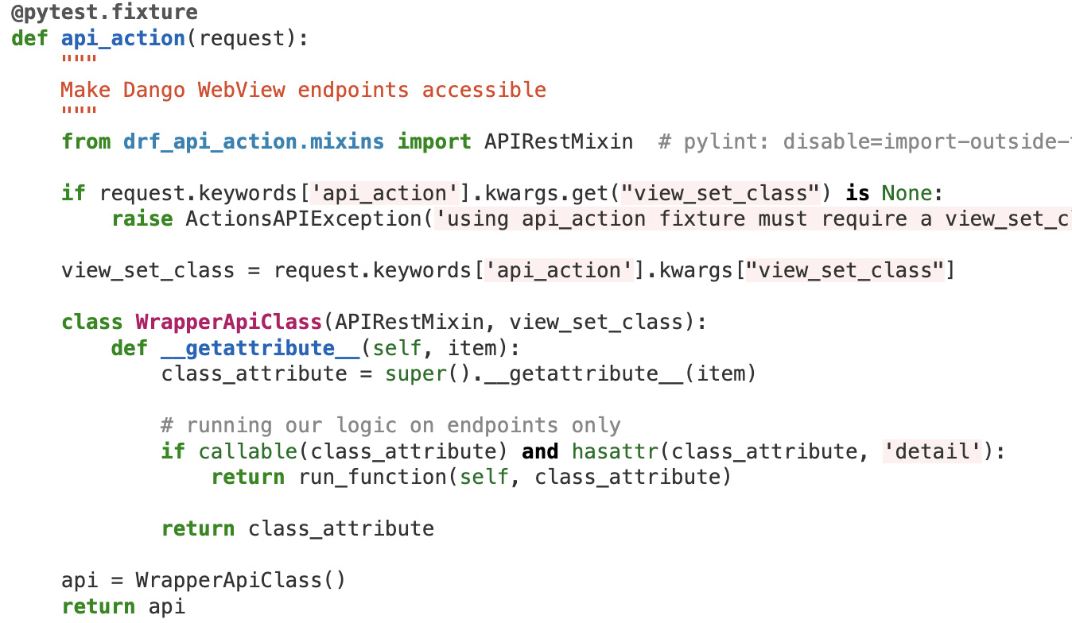
Put it All Together
drf-api-action internals

Slide 19
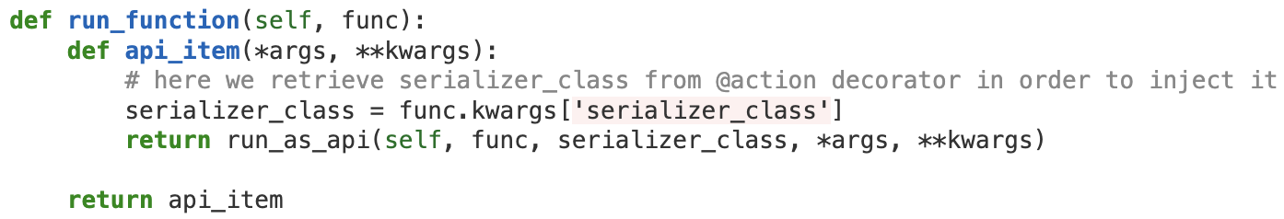
Put it All Together
drf-api-action internals

Slide 20
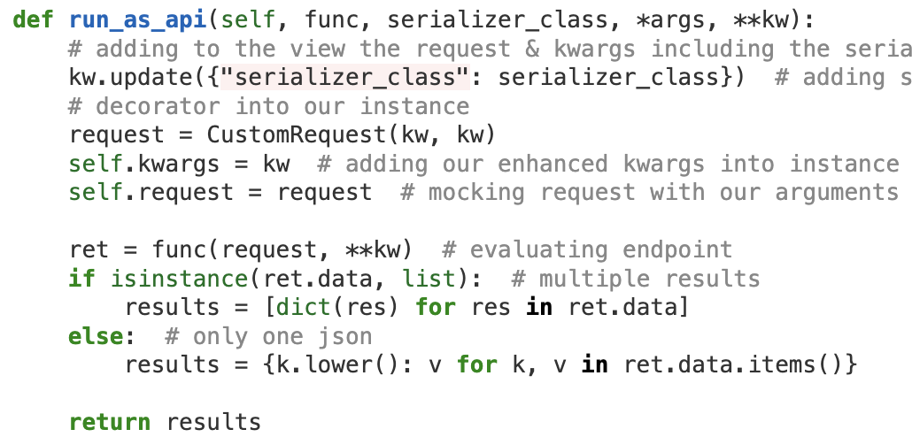
Put it All Together
drf-api-action internals

Slide 21
Explicitly & Simplicity drf-api-action benefits & examples
No code addition needed in ViewSet class.
No need to use `reverse` function or use an explicit url.
Calling endpoints is easy.

Slide 22
Explicitly & Simplicity drf-api-action benefits & examples

Slide 23
Method traceback are explicit drf-api-action benefits & examples
Instead of getting 500 or 400 we can catch the specific exception!

Slide 24
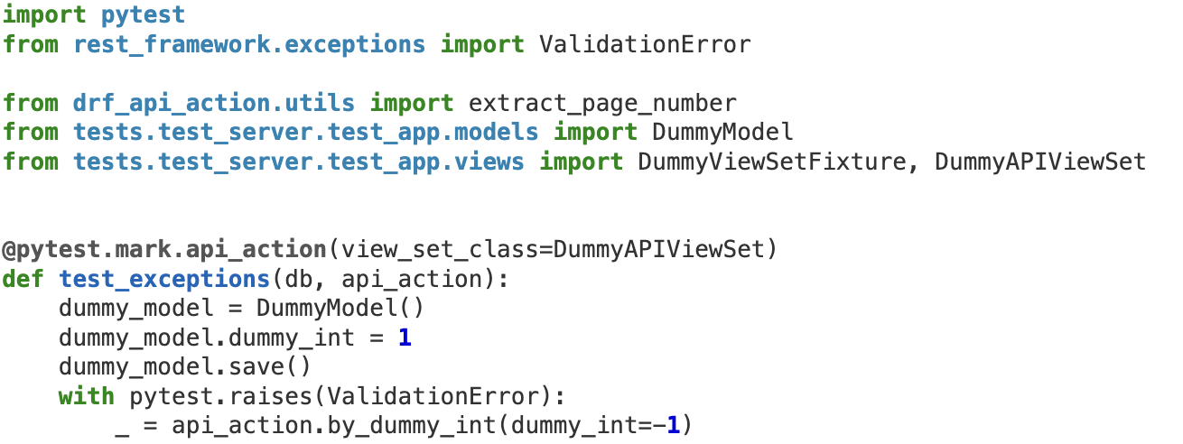
Method traceback are explicit drf-api-action benefits & examples

Slide 25
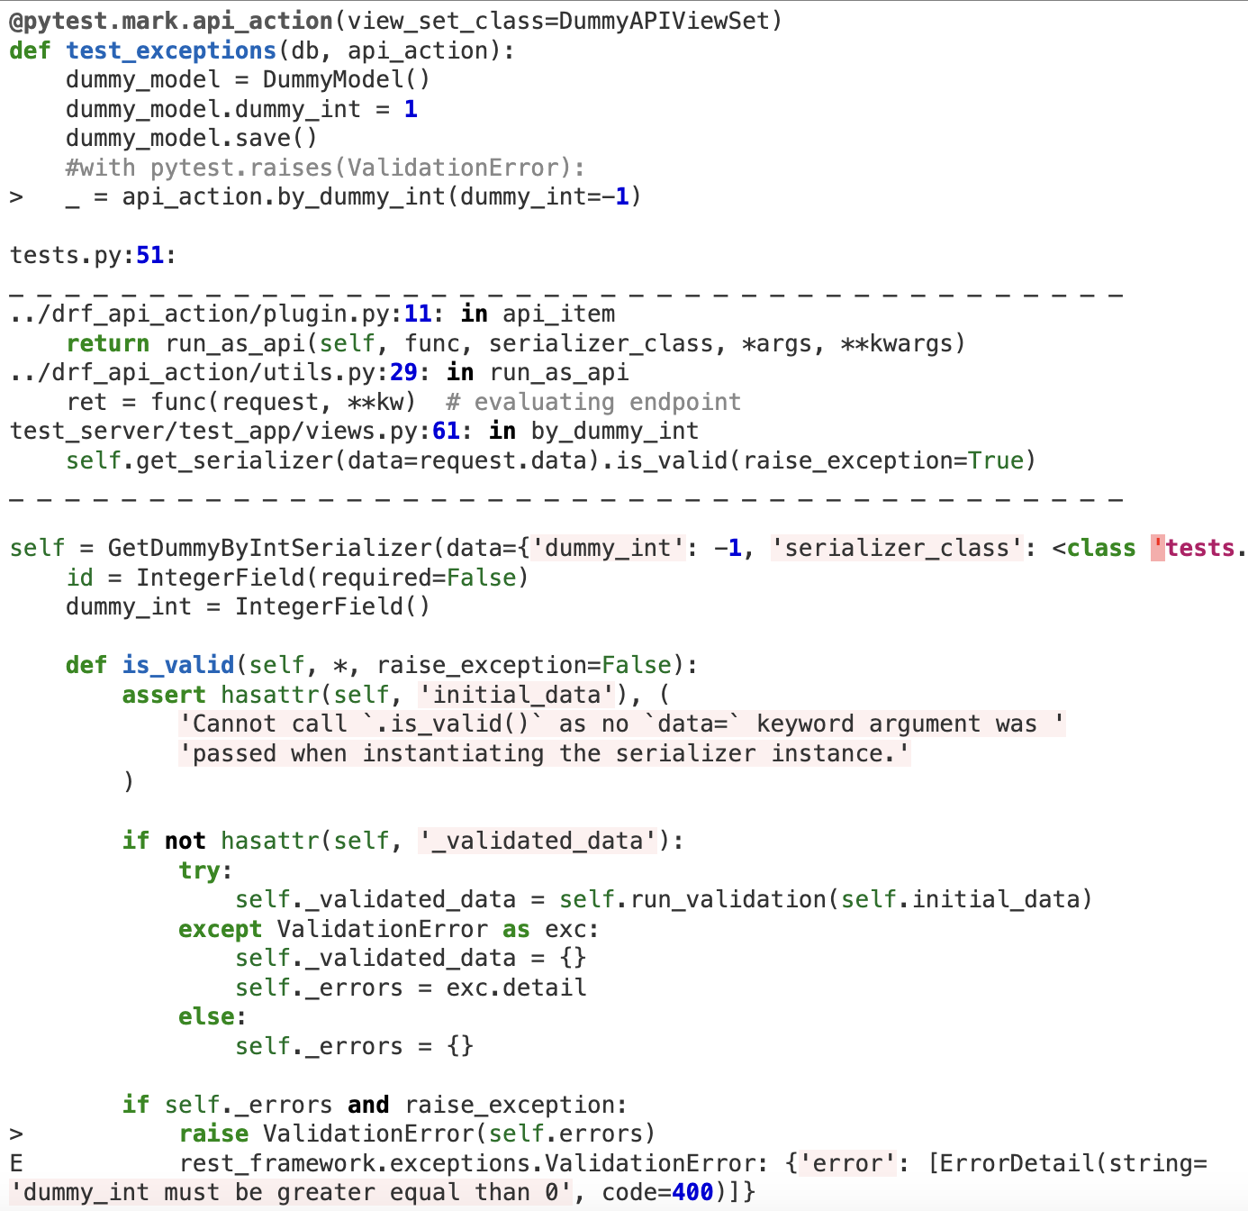
Method traceback are explicit drf-api-action benefits & examples

Slide 26
Pagination drf-api-action benefits & examples
We can test pagination mechanism and get bulks!

Slide 27
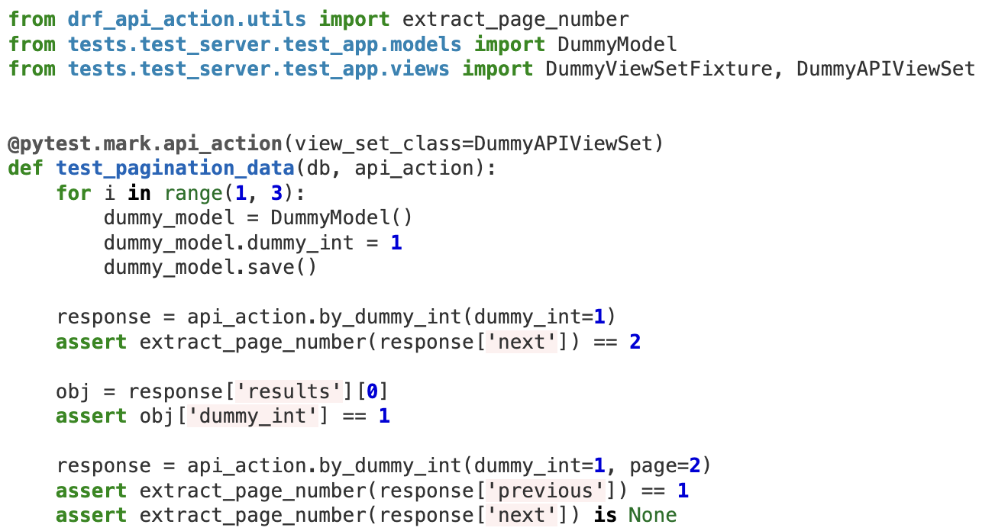
Pagination drf-api-action benefits & examples

Slide 28
Thank You!!!
Any Questions?

